Slide 1
Topic 4 The Relational Data Model and Relational Database Constraints
Ir. Endang Ripmiatin, MT
Program Studi Teknik Informatika
Universitas Al Azhar Indonesia
Oktober 2017

Slide 2
Outline
The Relational Data Model and Relational Database Constraints
Relational Model Constraints and Relational Database Schemas
Update Operations, Transactions, and Dealing with Constraint Violations

Slide 3
Relational Model Concepts
Relational Data Model
The model was first proposed by Dr. E.F. Codd of IBM in 1970 in the following paper: "A Relational Model for Large Shared Data Banks," Communications of the ACM, June 1970.
The above paper caused a major revolution in the field of Database management and earned Ted Codd the coveted ACM Turing Award.

Slide 4
The Relational Data Model and Relational Database Constraints
Relational Data Model
Relational model
First commercial implementations available in early 1980s
Has been implemented in a large number of commercial system
Hierarchical and network models
Preceded the relational model
From previous edition

Slide 5
Relational Model Concepts
Relational Data Model
Represents data as a collection of relations
Table of values
Row
Represents a collection of related data values
Fact that typically corresponds to a real-world entity or relationship
Tuple
Table name and column names
Interpret the meaning of the values in each row attribute

Slide 6
INFORMAL DEFINITIONS
Relational Data Model
RELATION: A table of values
A relation may be thought of as a set of rows.
A relation may alternately be thought of as a set of columns.
Each row represents a fact that corresponds to a real-world entity or relationship.
Each row has a value of an item or set of items that uniquely identifies that row in the table.
Sometimes row-ids or sequential numbers are assigned to identify the rows in the table.
Each column typically is called by its column name or column header or attribute name.
From previous edition

Slide 7
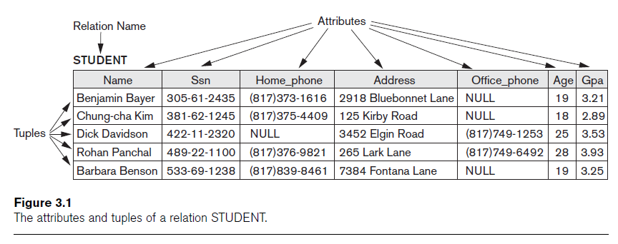
Relational Model Concepts (cont’d.)
Relational Data Model

Slide 8
Domains, Attributes, Tuples, and Relations
Relational Data Model
Domain D
Set of atomic values
Atomic means each value indivisible
Specifying a domain
Data type specified for each domain

Slide 9
Domains an example
Relational Data Model
Examples of domains (some taken from page 147):
USA_phone_number: string of digits of length ten
SSN: string of digits of length nine
Name: string of characters beginning with an upper case letter
GPA: a real number between 0.0 and 4.0
Sex: a member of the set {female, male}
Dept_Code: a member of the set { CMPS, MATH, ENGL, PHYS, PSYC, ... }

Slide 10
Domains, Attributes, Tuples, and Relations (cont’d.)
Relational Data Model
Relation schema R
Denoted by R(A1, A2, ...,An)
Made up of a relation name R and a list of attributes, A1, A2, ..., An
Example: STUDENT(Name, SSN, ...)
Attribute Ai
Name of a role played by some domain D in the relation schema R
Degree (or arity) of a relation
Number of attributes n of its relation schema

Slide 11
Domains, Attributes, Tuples, and Relations (cont’d.)
Relation (or relation state)
Set of n-tuples r = {t1, t2, ..., tm}
Each n-tuple t
Ordered list of n values t =<v1, v2, ..., vn>
Each value vi, 1 ≤ i ≤ n, is an element of dom(Ai) or is a special NULL value
Example:
t = <'Barbara Benson', '533-69-1238', ‘(817)839-8461', '7384 Fontana Lane', null, 19, 3.25>
t[Name] = <'Barbara Benson'>, and t[SSN, GPA, Age] = <'533-69-1238',3.25, 19>.

Slide 12
Domains, Attributes, Tuples, and Relations (cont’d.)
Relational Data Model
Current relation state
Relation state at a given time
Reflects only the valid tuples that represent a particular state of the real world
Attribute names
Indicate different roles, or interpretations, for the domain

Slide 13
Characteristics of Relations
Relational Data Model
Ordering of tuples in a relation
Relation defined as a set of tuples
Elements have no order among them
Ordering of values within a tuple and an alternative definition of a relation
Order of attributes and values is not that important
As long as correspondence between attributes and values maintained

Slide 14
Characteristics of Relations (cont’d.)
Relational Data Model
Alternative definition of a relation
Tuple considered as a set of (<attribute>, <value>) pairs
Each pair gives the value of the mapping from an attribute A_{i} to a value v_{i} from dom(A_{i})
Use the first definition of relation
Attributes and the values within tuples are ordered
Simpler notation

Slide 15
Characteristics of Relations (cont’d.)
Relational Data Model
Values and NULLs in tuples
Each value in a tuple is atomic (indivisible)
Flat relational model
Composite and multivalued attributes not allowed
First normal form assumption
Multivalued attributes
Must be represented by separate relations
Composite attributes
Represented only by simple component attributes in basic relational model

Slide 16
Characteristics of Relations (cont’d.)
Relational Data Model
NULL values
Represent the values of attributes that may be unknown or may not apply to a tuple
Meanings for NULL values
Value unknown
Value exists but is not available
Attribute does not apply to this tuple (also known as value undefined)

Slide 17
Relational Model Notation
Relational Data Model
Relation schema R of degree n
Denoted by R(A₁, A₂, ..., A_{n})
Uppercase letters Q, R, S
Denote relation names
Lowercase letters q, r, s
Denote relation states
Letters t, u, v
Denote tuples

Slide 18
Relational Model Notation
Relational Data Model
Name of a relation schema: STUDENT
Indicates the current set of tuples in that relation
Notation: STUDENT(Name, SSN, ...)
Refers only to relation schema
Attribute A can be qualified with the relation name R to which it belongs
Using the dot notation R.A
Ex: STUDENT.Name

Slide 19
Relational Model Notation
Relational Data Model
n-tuple t in a relation r(R)
Denoted by t = <v₁, v₂, ..., v_{n}>
v_{i} is the value corresponding to attribute A_{i}
Component values of tuples:
t[A_{i}] and t.A_{i} refer to the value v_{i} in t for attribute A_{i}

Slide 20
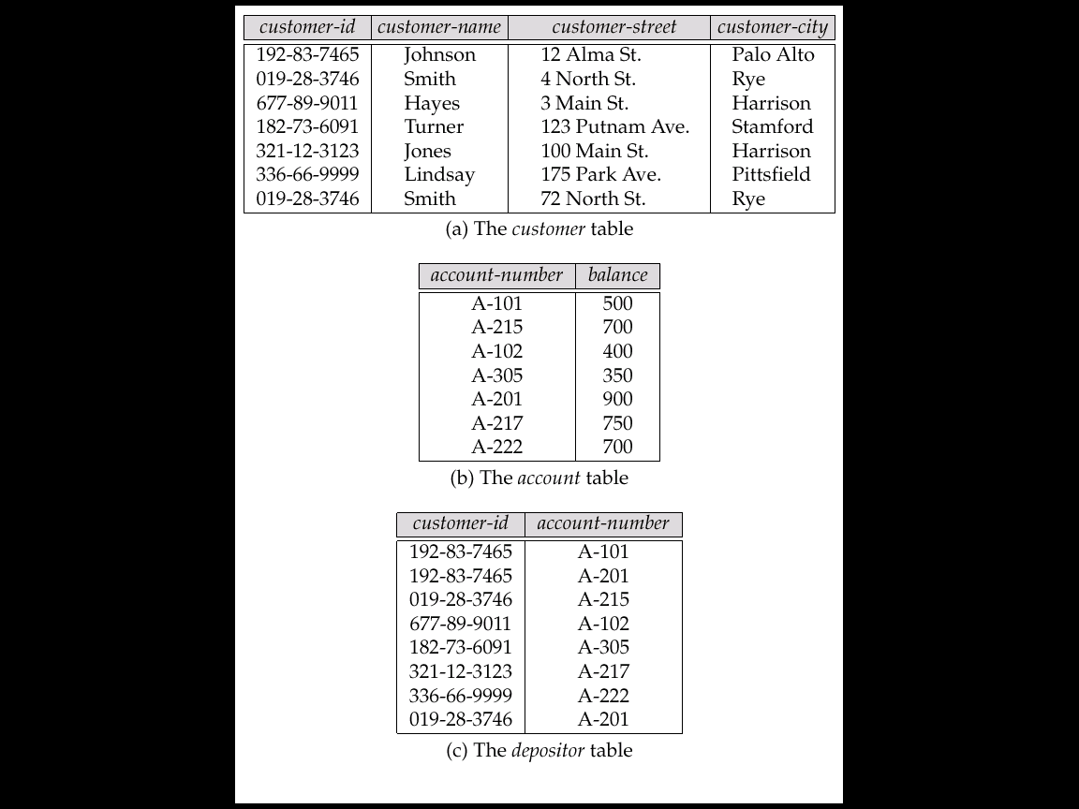
Example from previous meeting (#3)
Relation notation:
CUSTOMER(customer-id, customer-name, customer-street, customer-city)
customer(‘192-83-7465’, ’Johnson’, ‘12 Alma St.’, ‘Palo Alto’)
Attribute notation:
customer.customer-id or depositor.customer-id

Slide 21
Relational Model Constraints
Relational Database Constraint
Constraints
Restrictions on the actual values in a database state
Derived from the rules in the miniworld that the database represents

Slide 22
Domain Constraints
Relational Database Constraint
Typically include:
Numeric data types for integers and real numbers
Characters
Booleans
Fixed-length strings
Variable-length strings
Date, time, timestamp
Money
Other special data types

Slide 23
Key Constraints and Constraints on NULL Values
Relational Database Constraint
No two tuples can have the same combination of values for all their attributes.
Superkey
No two distinct tuples in any state r of R can have the same value for SK
Key
Superkey of R
Removing any attribute A from K leaves a set of attributes K that is not a superkey of R any more

Slide 24
Key Constraints and Constraints on NULL Values (cont’d.)
Relational Database Constraint
Key satisfies two properties:
Two distinct tuples in any state of relation cannot have identical values for (all) attributes in key
Minimal superkey
Cannot remove any attributes and still have uniqueness constraint in above condition hold

Slide 25
Key Constraints and Constraints on NULL Values (cont’d.)
Relational Database Constraint
Candidate key
Relation schema may have more than one key
Primary key of the relation
Designated among candidate keys
Underline attribute
Other candidate keys are designated as unique keys

Slide 26
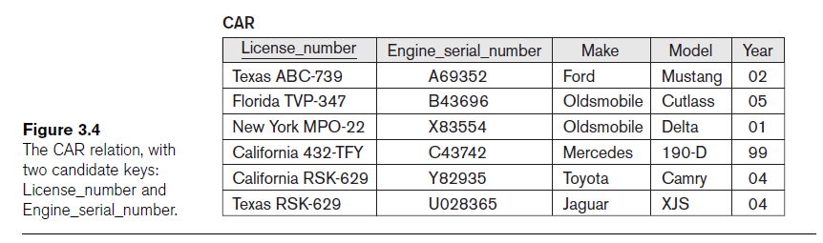
Key Constraints and Constraints on NULL Values (cont’d.)
Relational Database Constraint

Slide 27
Relational Databases and Relational Database Schemas
Relational Database Constraint
Relational database schema S
Set of relation schemas S = {R₁, R₂, ..., R_{m}}
Set of integrity constraints IC
Relational database state
Set of relation states DB = {r₁, r₂, ..., r_{m}}
Each r_{i} is a state of R_{i} and such that the r_{i} relation states satisfy integrity constraints specified in IC

Slide 28
Relational Databases and Relational Database Schemas (cont’d.)
Relational Database Constraint
Invalid state
Does not obey all the integrity constraints
Valid state
Satisfies all the constraints in the defined set of integrity constraints IC

Slide 29
Integrity, Referential Integrity, and Foreign Keys
Relational Database Constraint
Entity integrity constraint
No primary key value can be NULL
Referential integrity constraint
Specified between two relations
Maintains consistency among tuples in two relations

Slide 30
Integrity, Referential Integrity, and Foreign Keys (cont’d.)
Relational Database Constraint
Foreign key rules:
The attributes in FK have the same domain(s) as the primary key attributes PK
Value of FK in a tuple t₁ of the current state r₁(R₁) either occurs as a value of PK for some tuple t₂ in the current state r₂(R₂) or is NULL

Slide 31
Integrity, Referential Integrity, and Foreign Keys (cont’d.)
Relational Database Constraint
Diagrammatically display referential integrity constraints
Directed arc from each foreign key to the relation it references
All integrity constraints should be specified on relational database schema

Slide 32
Other Types of Constraints
Relational Database Constraint
Semantic integrity constraints
May have to be specified and enforced on a relational database
Application-specific restrictions that are unlikely to be expressible in DDL.
Use triggers and assertions
More common to check for these types of constraints within the application programs
Examples:
salary of a supervisee cannot be greater than that of her/his supervisor
salary of an employee cannot be lowered

Slide 33
Other Types of Constraints (cont’d.)
Relational Database Constraint
Functional dependency constraint
Establishes a functional relationship among two sets of attributes X and Y
Value of X determines a unique value of Y
State constraints
Define the constraints that a valid state of the database must satisfy
Transition constraints
Define to deal with state changes in the database

Slide 34
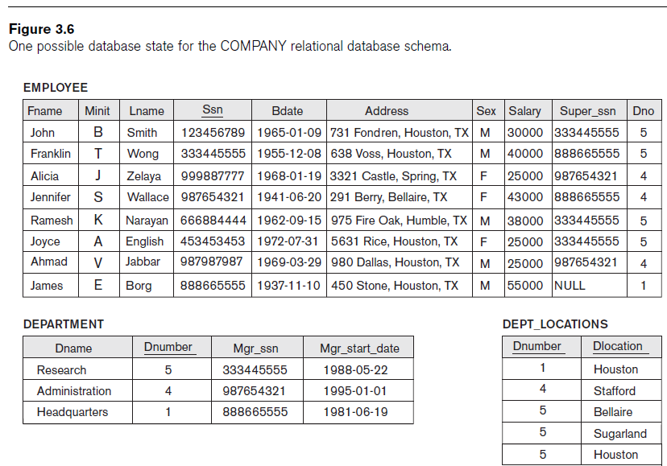
Database Schemas

Slide 35
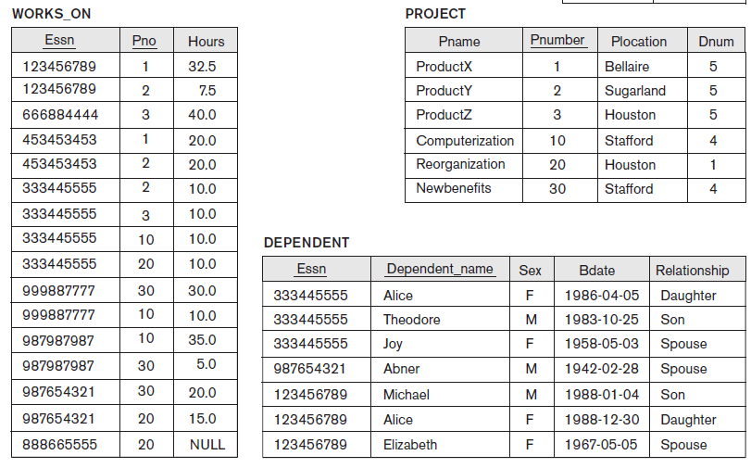
Relations Database Schemas

Slide 36
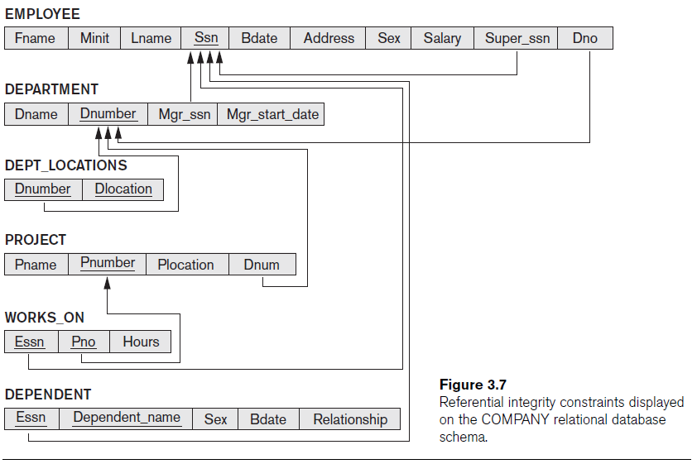
Relations Database Schemas

Slide 37
Update Operations, Transactions, and Dealing with Constraint Violations
Database Operations
Operations of the relational model can be categorized into retrievals and updates
Basic operations that change the states of relations in the database:
Insert
Delete
Update (or Modify)

Slide 38
The Insert Operation
Database Operations
Provides a list of attribute values for a new tuple t that is to be inserted into a relation R
Can violate any of the four types of constraints
If an insertion violates one or more constraints
Default option is to reject the insertion

Slide 39
The Delete Operation
Database Operations
Can violate only referential integrity
If tuple being deleted is referenced by foreign keys from other tuples
Restrict
Reject the deletion
Cascade
Propagate the deletion by deleting tuples that reference the tuple that is being deleted
Set null or set default
Modify the referencing attribute values that cause the violation

Slide 40
The Update Operation
Database Operations
Necessary to specify a condition on attributes of relation
Select the tuple (or tuples) to be modified
If attribute not part of a primary key nor of a foreign key
Usually causes no problems
Updating a primary/foreign key
Similar issues as with Insert/Delete

Slide 41
The Transaction Concept
Database Operations
Transaction
Executing program
Includes some database operations
Must leave the database in a valid or consistent state
Online transaction processing (OLTP) systems
Execute transactions at rates that reach several hundred per second

Slide 42
Summary
Characteristics differentiate relations from ordinary tables or files
Classify database constraints into:
Inherent model-based constraints, explicit schema-based constraints, and application-based constraints
Modification operations on the relational model:
Insert, Delete, and Update

